Slide 1

Welcome to the Shasta College Health Sciences Division!
Tonight’s information session: Vocational Nursing program – Application process
Thank you for attending

Slide 2
SHASTA COLLEGE VOCATIONAL NURSING PROGRAM
Application Process
Lorraine Day
Mindy Marlatt
8/3/2026

Slide 3
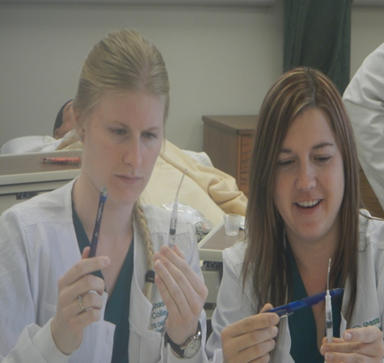
Information Sessions
Information sessions will be held twice a year; once in the spring and once in the fall.
Application filing periods will open approximately one month after the Information Session.
Please visit the VN website
for specific dates.

Slide 4
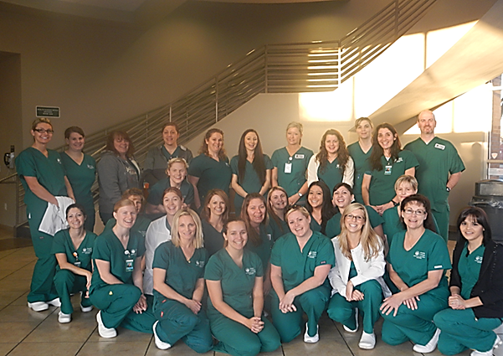
Applications
Applications for the Spring 2027 filing period are now available at www.shastacollege.edu/hsup under “Forms & Packets”
Application filing period:
September 8 through September 28,2026 at 4pm
  Applications will be time stamped as they are received.
    All packets turned in on a given day will receive a log-in number.
  Applications are accepted in-person or via mail.
    Mailed applications must be postmarked within the application period.
Eligible students will be notified of their working list number or program invitation by October 30th.

Slide 5

Program Start Dates
The next VN cohort will start the in Spring 2027
  Formal Program invitations for Spring 2027 will be sent out in October.

Slide 6
Make a Counseling Appointment
Melinda Marlatt (mmarlatt@shastacollege.edu)
Robert Waldren (rwaldren@shastacollege.edu)
Dr. Carolyn Borg (cborg@shastacollege.edu)
In order to schedule an appointment, you MUST have a Shasta College student ID number.
    To obtain a Shasta College student ID number, you will need to apply for admission with Shasta College
To schedule an appointment, call (530) 339-3600 or go online
      Go to Shasta college web site.
      Search for counseling
      On the left side of the screen, click on “Counseling Appointments”
      Click on “Schedule Appointment” for Health Sciences

Slide 7
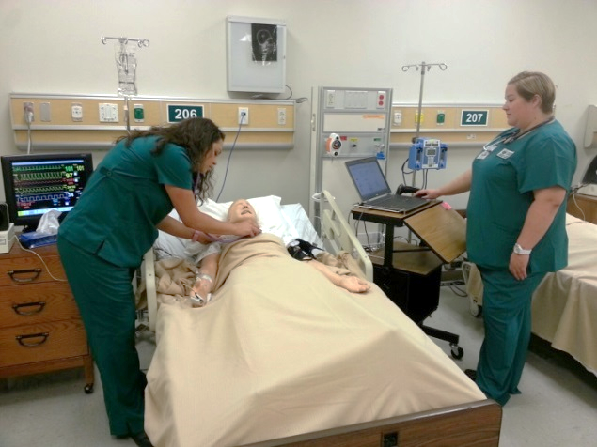
VN Requirements
Complete high school or equivalent
  Must submit official* transcript
Complete Prerequisite Requirements
  Must submit official* transcript except for Shasta College
  Prerequisite courses must be completed with a grade of “C” or better in each course. BIOL 6 will be accepted as an online course at this time.
NUTR 25 - Nutrition 3
PSYC 1A - General Psychology OR PSYC 14 - Psychology of Personal and Social Adjustment 3
BIOL 5* – Human Biology
BIOL 6* - Human Biology Lab 1
  *Anatomy & Physiology may be substituted for BIOL 5 & BIOL 6
*OFFICIAL RECORDS/TRANSCRIPTS are those that have been issued by another educational institution.
  Physical transcripts must be submitted in your sealed application packet. DO NOT SUBMIT PHYSICAL TRANSCRIPTS TO ADMISSIONS & RECORDS. Transcripts must be in a sealed envelope and remain unopened in order to be considered official. DO NOT OPEN. If an envelope has been opened (seal broken) prior to putting it in your application packet, it cannot be accepted for the purpose of application to the VN Program.
  Electronic transcripts must be sent to admissions@shastacollege.edu, and you must include a copy of the receipt from your transcript request transaction with your application packet.

Slide 8
In-Progress Pre-Requisite Courses
We will accept courses in progress for this application period.
Applicants will need to complete and pass pre-requisite courses prior to entering the program.

Slide 9
VN Requirements continued
Complete one of the following types of skills experience:
  A​ current Certified Nurse Assistant certificate (CNA). Those students who have a CNA from another state should apply for a California CNA. This must be current at the time of application.
  A copy of your Shasta College Medical Assisting certificate that was issued within the last 3 years.
  A completed Work Experience Verification Form and supporting letter showing employment with healthcare experience (>200 hours, with direct human care/contact, within the last 3 years). Clerical positions such as medical scribe, patient registration, and reception are non-direct human care/contact and therefore do not meet the Work Experience requirement.
Complete all required Clinical Requirements (immunizations or titers)

Slide 10
Why Do You Need Clinical Requirements?
All our programs incorporate clinical experiences as a vital component. To ensure you develop essential skills and effectively apply theoretical knowledge in real-world settings, we collaborate with healthcare organizations, placing students directly within their agencies.
The clinical requirements are set by our clinical partners – we are guests in their houses and must abide by their rules.
Notes:
Antibody to hepatitis B surface antigen

Slide 11
What’s Required for Application?
Vaccination only
Vaccination OR Titer
Titer only
  Tetanus, Diphtheria, Pertussis (TDaP)
    Proof of one-time dose as an adult. A TDaP is good for 10 years.
      If your TDaP is older than 10 years, you can receive a Td booster
      Submit proof of your original TDaP and the Td booster
  Varicella
  Measles, Mumps, & Rubella (MMR)
    Proof of either the 2-dose vaccination series OR proof of a titer showing positive immunity
      Both Varicella and MMR are 2-dose vaccination series; the 2 doses are given at least 4 weeks apart.
      If you wish to get a titer after receiving the 2 doses, you must wait a minimum of 4 weeks but ideally 6-8 weeks after your final dose.
  Hepatitis B
    Qualitative titers will be accepted; however Quantitative titers are preferred.
    Quantitative titers need to be Surface AB IgG not AG, Core IgM or ACIF.
    **If your Hep B titer indicates the need to repeat the vaccination series, you will have to re-titer 6-8 weeks after your last vaccination to show proof of immunity.
    Titers must be: IgG, showing positive immunity

Slide 12
Titer Questions
  Why a quantitative titer?
  A quantitative titer will show the number result of your antibody count and a reference range to compare that number to.
  Example: result= 12, reference ranges: 0.0-9.9 = non-immune, 9.9 or above = immune. Because your result is 12, you are considered immune.
  A qualitative titer will only positive or negative. If you are negative, you can’t be sure how many boosters you may need if you don’t know how far away your result is from the immune level.
How to Get Titers
1. Obtain a lab order
  You must have a written order from a provider to have titers drawn:
    You can go to your primary care provider, or if you don’t have one,
    You may visit websites like schooltiters.com or requestatest.com (look for the “Immunity Panel” test) to have a lab order emailed to you
2. Go to a lab to have blood drawn
  Titers must be IgG titers.
  Hepatitis B titer must be the surface antibody.
  .
Unsure if your titers fit the requirements? Email a copy to lday@shastacollege.edu for review.

Slide 13
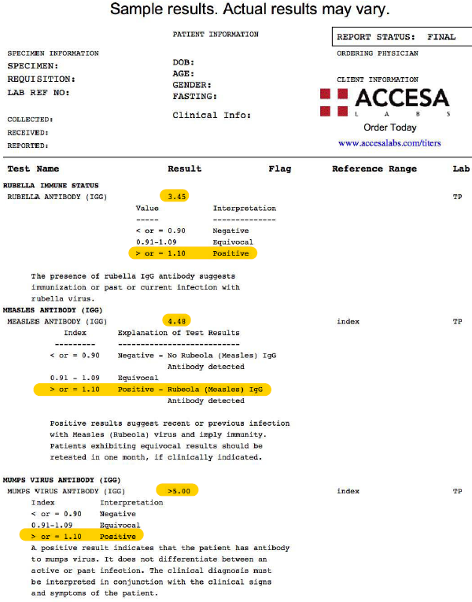
Sample Titer Report

Slide 14
Contact Information
Lorraine Day, Student Services Specialist – lday@shastacollege.edu
Mindy Marlatt, Counselor – mmarlatt@shastacollege.edu
Robert Waldren, Counselor – rwaldren@shastacollege.edu
Caroline Borg - Counselor - cborg@shastacollege.edu

