Slide 1


Slide 2

How are you feeling today?

Slide 3
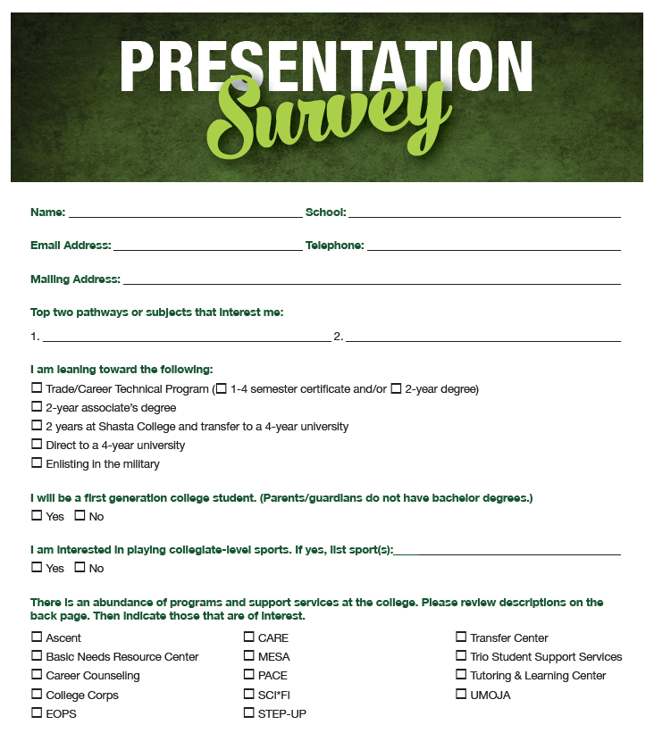
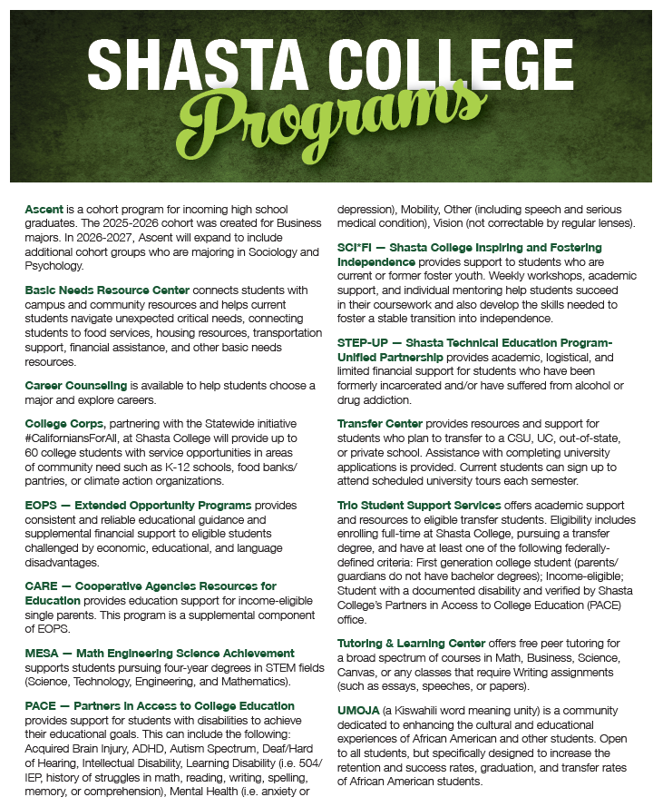

Slide 4

My career & education plans
Trade/Career Certificates
2 year degree & then work
2 yr degree then transfer to university
4 yr university
Enlist in military
Work

Slide 5
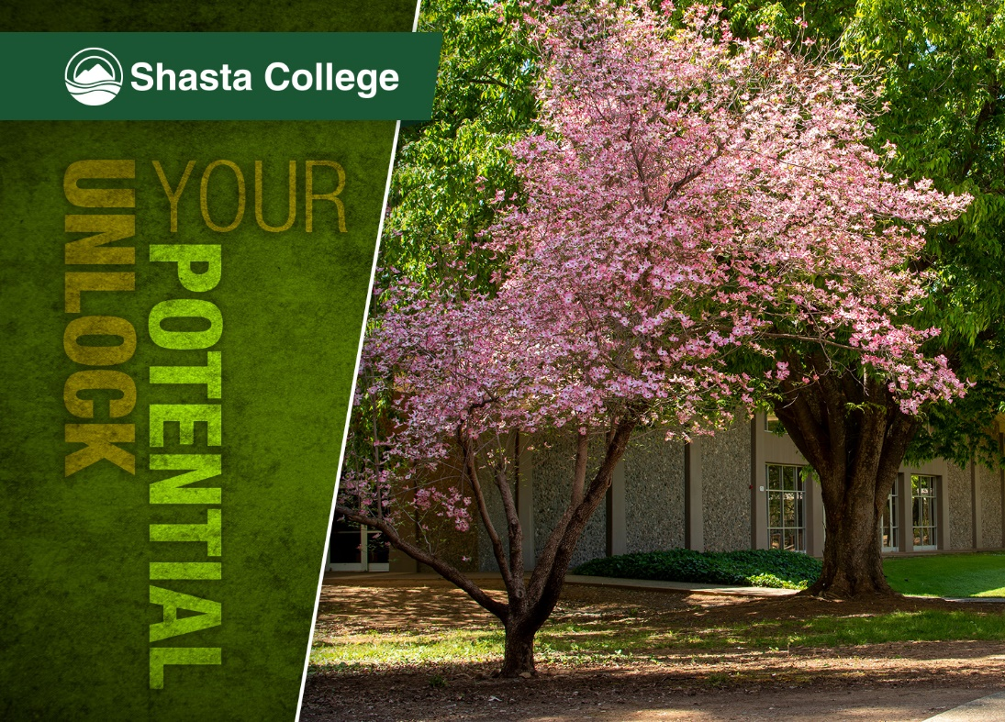
In this first section of the presentation, we will cover
Shasta College 101
  Scheduling and campus options
  Student Life
  Interest Areas
  Career Exploration
  Career Technical Certificates
Transfer Opportunities

Slide 6

Flexible classes
Build your own schedule
Day/night classes
On campus, hybrid, or online
Fall/Spring & Summer sessions
8 week compressed courses
Shasta College Campuses:
Redding Campus
Health Sciences &
University Center
(Downtown Redding)
Tehama Campus
(Red Bluff)
Intermountain Campus
(Burney)
Trinity Campus
(Weaverville)

Slide 7

Student Life!
Arts Art Gallery, Choir, Chorale, Dance, Theatre,
Music: Concert Orchestra, Symphonic Band, Jazz
Athletics Baseball, basketball, beach volleyball, football, soccer, softball, swim & dive, track & field, volleyball, wrestling
Clubs Join one of our diverse student clubs or start your own!
Student Senate Be a part of the student government and have a voice in college decision-making.
Events Enjoy a variety of social, cultural, and educational events throughout the year.
Global Education Expand your horizons through our study abroad programs

Slide 8

10 Interest Area Pathways
If you already know your path Get started by meeting with an academic counselor. Our counselors specialize in areas of interest or student support services and will help students create education plans.
81 Degrees - 25 AD-T & 56 Local
(AD-T: Associate Degree for Transfer)
39 Certificates - 8 Noncredit Certificates
1 Bachelor of Science Degree
Health Information Management

Slide 9


Slide 10

Out of these 5 Interest Areas which is your top pick?
Earth & Environment
Science, Technology, Engineering & Math
Industrial Technology
Business, Computer Technology & Hospitality
Language & Literature

Slide 11

Out of these 5 Interest Areas which is your top pick?
Education
Visual & Performing Arts
People, Culture & Society
Public Safety
Health & Wellness

Slide 12

Career Exploration/Undecided
Maybe you aren’t sure about your pathway.
Our career counselors can help you:
Clarify your interests, personality style, work values, and preferred skills
Explore career information
Empower you to be an active participant in your career planning journey
Identify potentially satisfying majors and careers
Create an action plan
Manage your career decision-making process

Slide 13

Career/Technical Education
Earn a Certificate in as little as 1-semester for in-demand jobs:
Accounting
Agriculture
Automotive
Business
CNC Operator
(Manufacturing Industries)
CIS
(Computer Information Systems)
Culinary Arts
Diesel
Digital Arts
ECE
(Early Childhood Education)
Fire Technology
GIS (Geographic Information Systems)
Heavy Equipment
Logging Operations
Nursing
Truck Driving
Welding
and more.....

Slide 14
Transfer to a University
Complete your first two years at Shasta College
Guaranteed acceptance options at a California State University (CSU) or University of California (UC)
If you are interested in transferring to an out-of-state program ie Oregon, Nevada and Washington, as well as other states, talk to a Shasta College counselor about your options.
Your AA degree
The Shasta College Transfer Center is located on the Redding Campus in Room 2143 and provides many support services for students intending to transfer to a university.

Slide 15

AD-T Program
Guaranteed Admission to one of the 23 CSUs with Junior Status
Only 60 more semester units
for a bachelor’s degree
Possibility of GPA bump

Slide 16


TAG…you’re in!
Guaranteed Admission to one of six
UC campuses Includes: Davis, Santa Cruz, Merced,
Santa Barbara, Irvine, and Riverside
Three do not participate: Berkeley, San Diego and UCLA
Early review of academic record and early admission notification (offered at some colleges)
Specific guidance on major preparation
and general education coursework

Slide 17
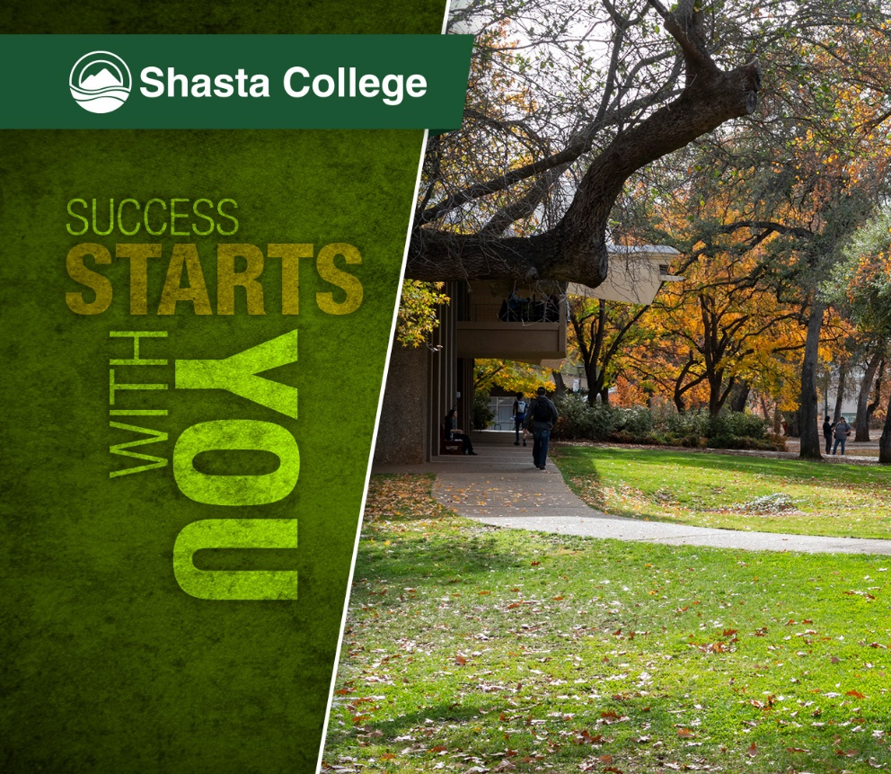
In this next section, we will cover
Student Support Programs
Financial Aid
Seniors Applying or Re-Applying to Shasta College
Important Dates

Slide 18


Slide 19
We’re Here to Help You Succeed
with Programs and Services for Everyone!
  Basic Needs Resource Center
  Helps students navigate unexpected critical needs, connecting them to food services, housing resources, transportation support, financial assistance and other basic needs.
  Career Counseling & Career Café Assistance for students and graduates seeking employment, internships, worksite learning, and career readiness assistance. (Redding)
  Food Services On Campus
  Cafeteria, The Bistro (Culinary program run restaurant) and Starbucks (Redding)
  Health & Wellness Services
  Nursing services, doctor visits, dental
  cleanings, health screenings, as well as mental health counseling.
  Student Success Center / Extended Ed Campuses
  Visit our One Stop Centers for assistance with the Shasta College application, financial aid applications, registering for classes and more.
  Tutoring & Learning Centers FREE peer tutoring for a broad spectrum of courses in Math, Business, Science, canvas, or any classes that require Writing assignments at the Redding, Red Bluff, Weaverville and Burney Campuses.
  On Campus Dorms Cost ranges from $4,375-$4,675 for double occupancy & $8,500-$9,100 for single occupancy. Based on number of days. Meal plans can be purchased separately from Food Services. (Redding)

Slide 20
Programs and Services for Specific Populations
  EOPS
  Extended Opportunity Programs and Services offers education guidance & supplemental financial support to eligible students (Apply to program)
  PACE
  Partners in Access to College Education for students with disabilities provides support and services to help students achieve their goals (Apply to program)
  SCI*FI (ages 13-26)
  Shasta College Inspiring & Fostering Independence offers support for current or former foster youth.
  TRIO
  TRIO Student Support Services provide academic support and resources for eligible transfer students who are first generation and intend to transfer.
  (Apply to program)

Slide 21

Which program supports students in acquiring equal access to Shasta College programs and facilities?
Quiz Question 1
EOPS
PACE
SCI*FI

Slide 22

Dreamers Welcome
For students who are undocumented
We have staff on campus ready to help you with specific processes and make connections to community resources.
You BELONG here, and we want to help you succeed!
To get started, please view Applying to Shasta College/California Residency and Financial Aid / Resources.
Dreamer Outreach Liaison
Extended Ed (Red Bluff, Weaverville & Burney support)
Milli Israel
Student Services Coordinator
530-242-7598
misrael@shastacollege.edu
Maribel Fausto
Student Success Facilitator
530-840-2422
mfausto@shastacollege.edu
Teo Guillen
Student Success Coordinator
530-840-2403
tguillen@shastacollege.edu

Slide 23



Financial Aid
Complete one of the following:
Free Application for Federal Student Aid (FAFSA)
CA Dream Act Application (CADAA)
Graduating Seniors who plan to start college in Fall 2026 need to complete the Fall 26/Spring 27 FAFSA
The FAFSA and CADAA needs to be completed every year.
We advise all students to complete financial aid applications even if you think you may not qualify and receive any assistance.

Slide 24

How do you get free tuition?
There are two ways students can qualify for FREE tuition
You qualify for the California College Promise Grant (CCPG) based on your financial need.
If you do not qualify for the CCPG instead complete the Shasta College Promise Grant application which is not based on financial need, but does require the 5 steps featured in this green box
Eligibility requirements for Shasta Promise Grant:
Complete FAFSA or CADAA
Complete New Student Online Orientation
Meet with a counselor and complete an ed plan
Enroll as a full-time student (12+ units)
Maintain a 2.0 GPA

Slide 25

What are the names of the two tuition free grants?
Quiz Question 2
Two Years Free For All Grant & CCC for North State Senior Grads Grant
Affordable College Fun Grant & Shasta College For All Grant
California College Promise Grant & Shasta College Promise Grant

Slide 26

Cost Comparisons
$2,394
$0
$13,676
$29,868
*Does not include cost of books, transportation or housing. **Prices reflect 2025-2026 estimated cost of attendance

Slide 27

Applying to
Shasta College
New Applicants
Seniors who do not have Shasta College accounts will want to apply prior to Spring Ed Planning visits at the local high schools which begin in February. Your account needs to be set up in order for you to have an ed plan created for you by a Shasta College counselor.
Apply by January 21st, 2026 to ensure your account is set up and ready for those visits.
Existing Shasta College Accounts
Seniors who already have Shasta College accounts are required to
re-apply to the college.
Re-apply by March 18th, 2026
Those who do not re-apply will not be able to register for Summer or Fall classes until they re-apply.

Slide 28

Seniors without account should apply by this date:
Quiz Question 3
October 2, 2025
January 21, 2026
March 30, 2026

Slide 29
Seniors with accounts should apply by this date:
Quiz Question 4
October 1, 2025
February 29, 2026
March 18, 2026

Slide 30
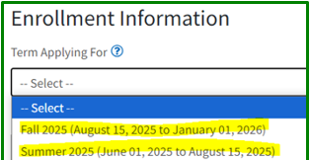
Important Application Notes
Very Important! Be sure you select the correct term on the application.
Summer 2026 is the best option even if you may not plan on taking classes the summer after graduating. This leaves the option open if your plans change.
If you choose Fall 2026 and then decide to take courses in the Summer you will have to re-apply.
Include your Social Security Number This is how colleges match you with your financial aid applications.
Use a personal email address. Access to your school email ends after you graduate. Initial college account information will be sent to your email address & future notifications will go to your new college email account.
Fall 2026 (August 15, 2026 to January 01, 2027
Summer 2026 (June 01, 2026 to August 15, 2026)

Slide 31

North State Promise
Priority Registration
Seniors can receive priority registration at Shasta College when they complete the following 2 steps by April 11th:
Orientation - Log into your Shasta College Portal to access. Takes about 45 minutes to complete.
Ed Plan approved by a college counselor

Slide 32
The 2 steps to complete by April 11th to get priority registration are:
Quiz Question 5
College Application & Financial Aid
Orientation & Education Plan
FAFSA & Orientation

Slide 33
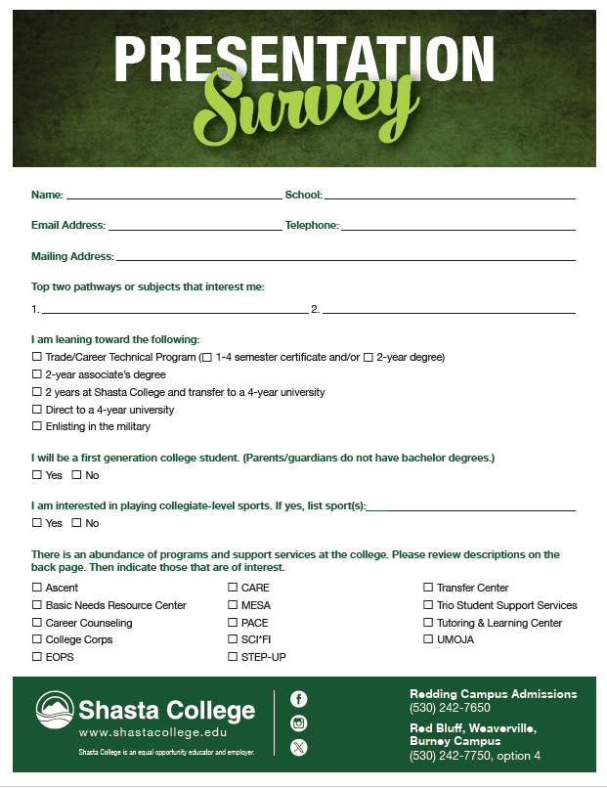
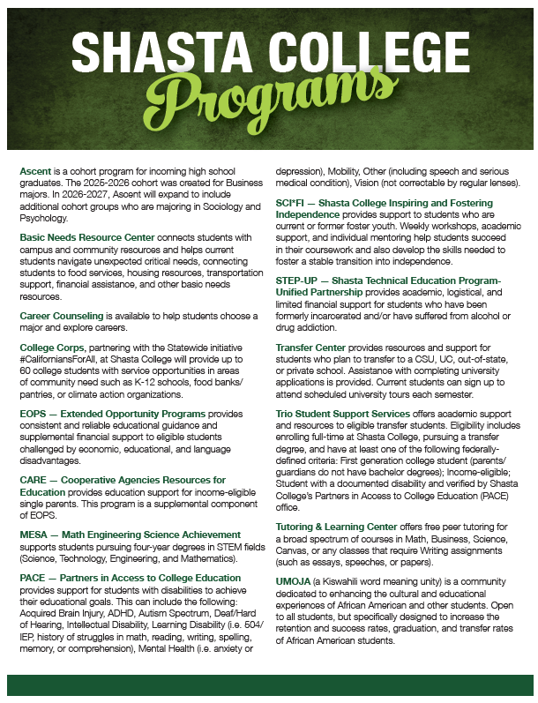

Slide 34
Important Dates
By January 21st Seniors apply for first time
By March 18th Seniors with accounts re-apply
Starting October 1st
Complete Fall 2026/Spring 2027 FAFSA & CADAA applications *Must complete yearly*
By March 2nd 2026
Completing the FAFSA and CADAA by this date can ensure you receive the maximum amount of financial aid.
By APRIL 11th 2026
Seniors must have 1) Orientation, 2) Ed Plan and 3) FAFSA or CADAA completed to receive North State Promise Priority Registration in May, plus the *auto-awarding of the Shasta College Promise 2 Years Free Tuition. *Free tuition auto-awarded to seniors who do not qualify for free tuition through the California College Promise Grant (CCPG) and have completed the 3 steps listed.

Slide 35
Goal is to complete the following by these dates:
Quiz Question 6
FAFSA/CADAA by March 2nd & Orientation/Ed Plan by April 11th
FAFSA/CADAA by October 1st & Orientation/Ed Plan by March 2nd
FAFSA/CADAA by January 1st & Orientation/Ed Plan by May 31st

Slide 36

Questions?
CALL
Redding Campus:
(530) 242-7650
Intermountain, Tehama and Trinity Campuses:
(530) 242-7750, option 4
VISIT
Redding: 11555 Old Oregon Trail
Burney: 37581 Mountain View Rd
(Intermountain)
Red Bluff: 770 Diamond Avenue, Red Bluff
Weaverville: 30 Arbuckle Ct, Weaverville
EMAIL
Redding Campus: admissions@shastacollege.edu
Extended Ed Campuses: ExtEdSS@shastacollege.edu

