Slide 1


Slide 2

How are you feeling today?

Slide 3

My career & education plans
Trade/Career Certificates
2 year degree & then work
2 yr degree then transfer to university
4 yr university
Enlist in military
Work

Slide 4
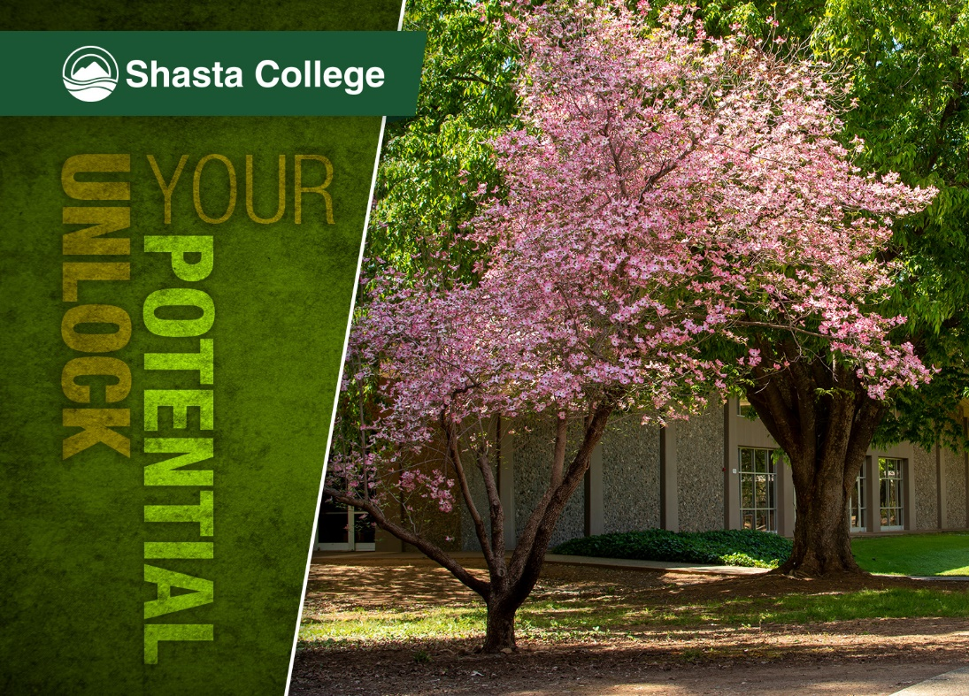
In this first section of the presentation, we will cover
Shasta College 101
  Scheduling and campus options
  Student Life
  Interest Areas
  Career Exploration
  Career Technical Certificates
Transfer Opportunities

Slide 5

Options at
Shasta College
Build your own schedule
Day/night classes
On campus, hybrid, or online
Fall/Spring & Summer sessions
8 week compressed courses
Shasta College Campuses:
Redding Campus
Health Sciences &
University Center
(Downtown Redding)
Tehama Campus
(Red Bluff)
Intermountain Campus
(Burney)
Trinity Campus
(Weaverville)

Slide 6

Get Involved
Student Life!
Arts Art Gallery, Choir, Chorale, Dance, Theatre,
Music: Concert Orchestra, Symphonic Band, Jazz
Athletics Baseball, basketball, beach volleyball, football, soccer, softball, swim & dive, track & field, volleyball, wrestling
Clubs Join one of our diverse student clubs or start
your own!
Student Senate Be a part of the student government and have a voice in college decision-making.
Events Enjoy a variety of social, cultural, and educational events throughout the year.
Global Education Expand your horizons through our study abroad programs

Slide 7

10 Interest Area Pathways
If you already know your path Get started by meeting with an academic counselor. Our counselors specialize in areas of interest or student support services and will help students create education plans.
81 Degrees - 25 AD-T & 56 Local
(AD-T: Associate Degree for Transfer)
43 Certificates - 8 Noncredit Certificates
1 Bachelor of Science Degree
Health Information Management

Slide 8


Slide 9

Out of these 5 Interest Areas which is your top pick?
Earth & Environment
Science, Technology, Engineering & Math
Industrial Technology
Business, Computer Technology & Hospitality
Language & Literature

Slide 10
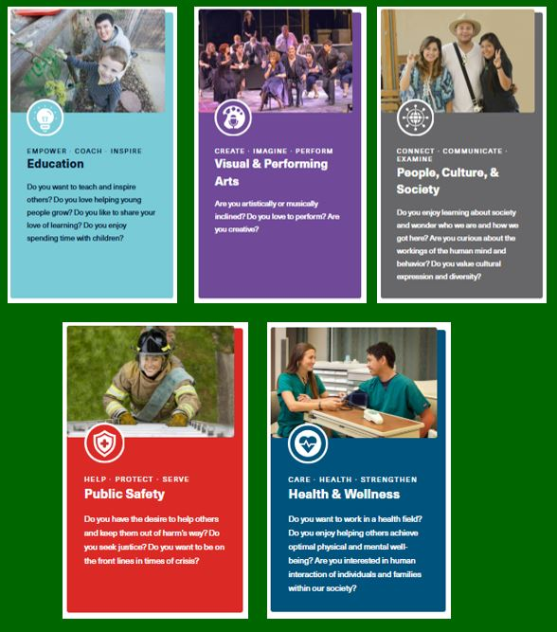
Out of these 5 Interest Areas which is your top pick?
Education
Visual & Performing Arts
People, Culture & Society
Public Safety
Health & Wellness

Slide 11

Career Exploration & Undecided
Maybe you aren’t sure about your pathway.
Our career counselors can help you:
Clarify your interests, personality style, work values, and preferred skills
Explore career information
Empower you to be an active participant in your career planning journey
Identify potentially satisfying majors and careers
Create an action plan
Manage your career decision-making process

Slide 12

Career/Technical Education
Earn a Certificate in as little as 1-semester for in-demand jobs:
Accounting
Agriculture
Automotive
Business
CNC Operator
(Manufacturing Industries)
CIS
(Computer Information Systems)
Culinary Arts
Diesel
ECE
(Early Childhood Education)
Fire Technology
GIS (Geographic Information Systems)
Heavy Equipment
Logging Operations
Nursing
Recording Arts
Welding
and more.....

Slide 13
CTE Focus
^{Diesel Technology}
^{Pathway Degrees:}
^{Diesel Technology (AS)}
^{4 semesters – 60.5 units}
^{Diesel Technology (C)}
^{3 semesters – 36.6 units}
^{Potential Careers:}
^{Bus and Truck Mechanic.}
Mobile Heavy Equipment Mechanic. Diesel Engine Specialist.
^{Salary:}
^{$45-$80K annually}
^{Water Treatment}
^{Pathway Degrees:}
^{Water/Wastewater Treatment (C)}
2 semesters + 1 Summer session – 18 units
^{Potential Careers:}
Wastewater Plant System Operator. System Manager. Environmental Engineer Technician.
^{Salary:}
^{$50-$84K annually}
^{Medical Assisting}
^{Pathway Degrees:}
^{Medical Assisting (C)}
^{2 semesters – 24 units}
^{Potential Careers:}
^{Medical Assistant.}
^{Front Office Assistant.}
^{Salary:}
^{$36-$46K annually}

Slide 14


Slide 15
Transfer to a University
Complete your first two years at Shasta College
Guaranteed acceptance options at a California State University (CSU) or University of California (UC)
If you are interested in transferring to an out-of-state program ie Oregon, Nevada and Washington, as well as other states, talk to a Shasta College counselor about your options.
Your AA degree
The Shasta College Transfer Center is located on the Redding Campus in Room 2143 and provides many support services for students intending to transfer to a university.

Slide 16
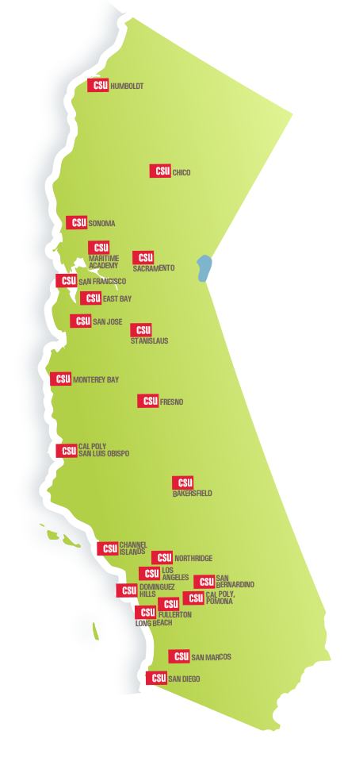
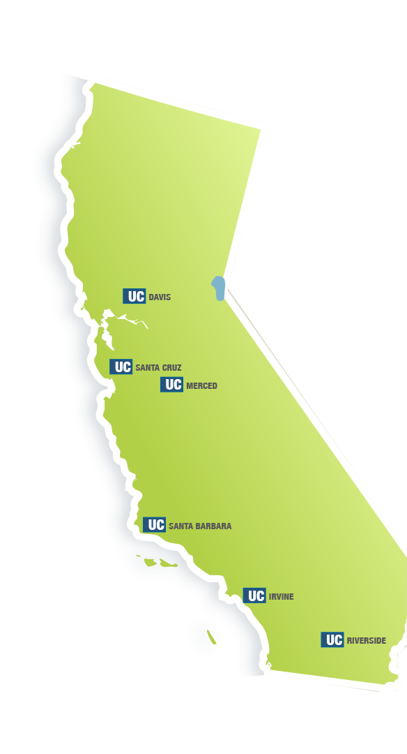

TAG…you’re in!
Transfer to a University
CSU
Guaranteed Admission to one of the 23 CSUs with Junior Status
Only 60 more semester units for a bachelor’s degree
Possibility of GPA bump
UC
Guaranteed Admission to one of six UC campuses Includes:
Davis
Santa Cruz
Merced,
Santa Barbara
Irvine
Riverside
wo
Three do not participate:
Berkeley
San Diego
UCLA

Slide 17
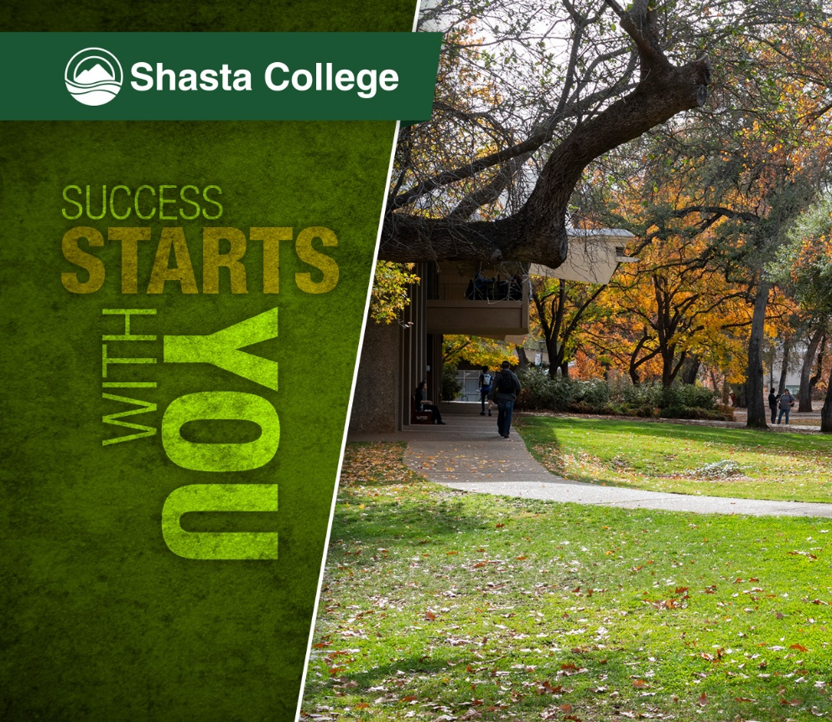
In this next section, we will cover
Student Support Programs
Financial Aid
Seniors Applying or Re-Applying to Shasta College
Important Dates

Slide 18
We’re Here to Help You Succeed
with Programs and Services for Everyone!
  Basic Needs Resource Center
  Helps students navigate unexpected critical needs, connecting them to food services, housing resources, transportation support, and financial assistance.
  Career Counseling & Career Services
  Food Services On Campus
  Cafeteria, The Bistro and Starbucks (Redding)
  Health & Wellness Services
  Nursing services, doctor visits, dental cleanings, health screenings, as well as mental health counseling.
  Student Success Center / Extended Ed Campuses
  Visit our One Stop Centers for assistance with creating a Shasta College account, financial aid applications, registering for classes and more.
  Tutoring & Learning Centers
  FREE peer tutoring for courses in Math, Business, Science, and Writing.
  On Campus Dorms Cost ranges from $4,480-$4,630 for double occupancy & $8,710-$9,010 for single occupancy. (Redding)

Slide 19
Programs and Services for Specific Populations
  EOPS
  Extended Opportunity Programs and Services offers education guidance & supplemental financial support to eligible students (Apply to program)
  PACE
  Partners in Access to College Education for students with disabilities provides support and services to help students achieve their goals (Apply to program)
  SCI*FI (ages 13-26)
  Shasta College Inspiring & Fostering Independence offers support for current or former foster youth.
  TRIO
  TRIO Student Support Services provide academic support and resources for eligible transfer students who are first generation and intend to transfer.
  (Apply to program)

Slide 20

Which program supports students with disabilities?
Quiz Question 1
EOPS
PACE
SCI*FI

Slide 21

All Are Welcome
For students who are undocumented
We have staff on campus ready to help you with specific processes and make connections to community resources.
You BELONG here, and we want to help you succeed!
To get started, please view Applying to Shasta College/California Residency and Financial Aid / Resources.
Redding Campus
Extended Ed
(Red Bluff, Weaverville & Burney support)
Milli Israel
Student Services Coordinator
Undocu-Liaison
530-242-7598
misrael@shastacollege.edu
Maribel Fausto
Student Services Coordinator
530-840-2422
mfausto@shastacollege.edu

Slide 22



Financial Aid
Complete one of the following:
Free Application for Federal Student Aid (FAFSA)
CA Dream Act Application (CADAA)
Graduating Seniors who plan to start college in Fall 2027 need to complete the Fall 27/Spring 28 FAFSA
The FAFSA and CADAA needs to be completed every year.
We advise all students to complete financial aid applications even if you think you may not qualify and receive any assistance.

Slide 23

How do you get free tuition?
There are two ways students can qualify for FREE tuition
You qualify for the California College Promise Grant (CCPG) based on your financial need.
If you do not qualify for the CCPG instead complete the Shasta College Promise Program application which is not based on financial need, but does require the 4 steps featured in this green box
Eligibility requirements for Shasta Promise Program:
Complete FAFSA or CADAA
Complete New Student Online Orientation
Meet with a counselor and complete an ed plan
Enroll as a full-time student (12+ units)
Review additional details on the Tuition Waivers flyer

Slide 24
What are the names of the two tuition free grants?
Quiz Question 2
Two Years Free For All Grant & CCC for North State Senior Grads Grant
Affordable College Fun Grant & Shasta College For All Grant
California College Promise Grant & Shasta College Promise Grant

Slide 25

Cost Comparisons
$2,412
$0
$13,676
$31,176
*Does not include cost of books, transportation or housing. **Prices reflect 2026-2027 estimated cost of tuition only

Slide 26

Beginning or Continuing
Your Shasta College Journey
 January 21, 2027
Create or update your account by January 21st
a
Note that it is mandatory for seniors to update an existing account.
When creating or updating your account reference the Guidance flyer
As long as questions are answered correctly, your student type will be updated from high school student to high school graduate.

Slide 27
Seniors should create or update their account by this date:
Quiz Question 3
October 2, 2026
January 21, 2027
March 30, 2027

Slide 28
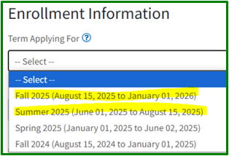
Guidance for Graduating Seniors
When creating or updating your account:
Choose the Summer 2027 term
Include your Social Security Number
(If applicable)
Use a personal email address
When creating or updating your account reference the Guidance flyer
Fall 2027 (August 15, 2027 to January 01, 2028
Summer 2027 (June 01, 2027 to August 15, 2027)

Slide 29
What term do we advise senior grads to choose?
Quiz Question 4
Summer 2027
Fall 2027
Spring 2027

Slide 30


Priority Registration
Seniors can receive priority registration of May 6th at Shasta College when they complete the following 2 steps by April 9th:
Orientation
Ed Plan

Slide 31
Complete these 2 steps by April 9th to receive priority registration:
Quiz Question 5
Orientation & Ed Plan
FAFSA & Campus Tour
Registration & FAFSA

Slide 32
Important Dates
October 1st Complete the FAFSA or CADAA
Fall 2027/Spring 2028 FAFSA & CADAA applications will open on October 1st *Must complete yearly*
January 21st Complete New Account​ Creation or Account Update by going to shastacollege.edu/start
March 2nd Completing the FAFSA and CADAA by this date can ensure you receive the maximum amount of financial aid.
APRIL 9th Complete 1) Orientation & 2) Ed Plan to receive priority registration on May 6, 2027
Extra Bonus High school seniors who, in addition to completing the orientation and ed plan,
have also completed the FAFSA or CADAA by April 9th, will be auto-awarded a tuition free grant.

Slide 33
There are many paths after high school.
Which statement is true?
Quiz Question 6
Shasta College can be your destination.
Shasta College can be your starting point.
Both are true.

Slide 34

Congratulations Class of 2027!
Whether you're pursuing a certificate or associate degree before beginning your career, or taking your first step toward transferring to a university, we're excited to be part of your journey and welcome you to the Knight family.

Slide 35
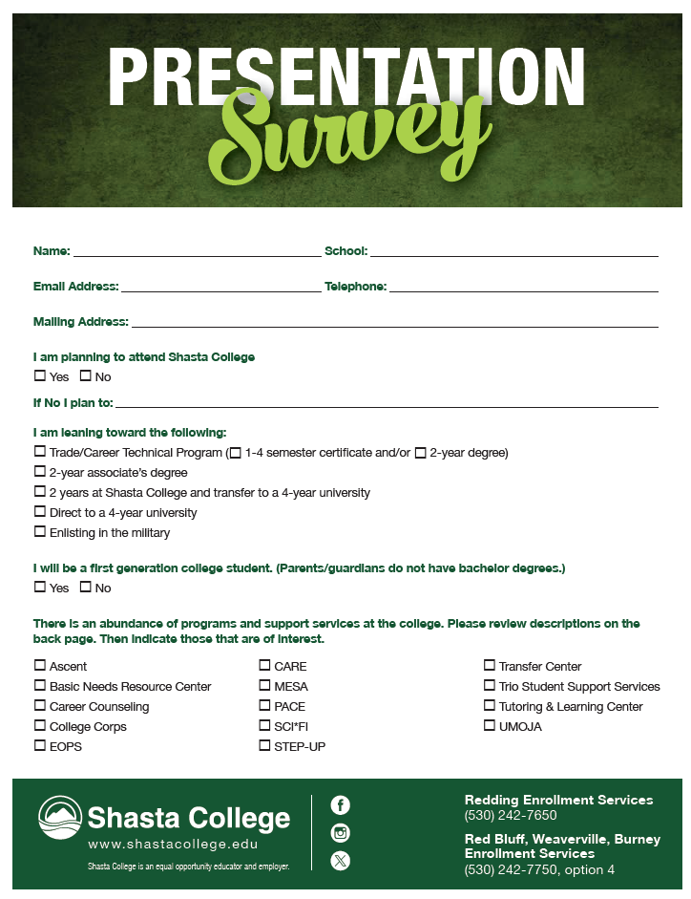
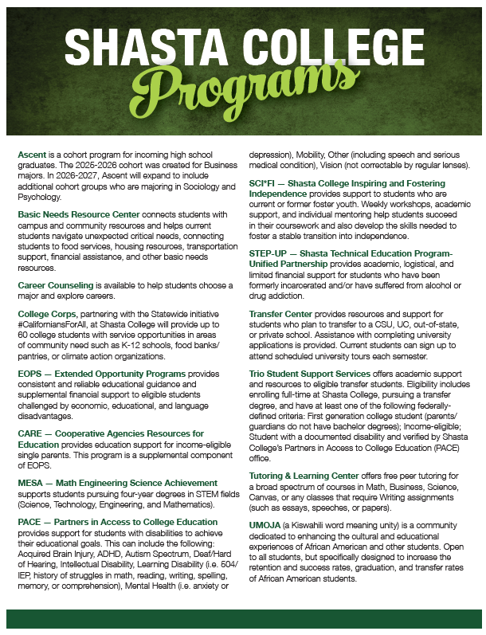

Slide 36
Quiz Questions Answer Key
#2 – PACE is the disability support program
#3 - California College Promise Grant & Shasta College Promise Grants provide free tuition.
#2 - January 21, 2027 is the goal date to create or update your account.
#3 – Summer 2027 is the term we advise senior to choose on application
#2 - Orientation & Ed Plan completed by April 9th = Priority Registration
#1 – Both, as Shasta College can be your starting point or destination

