Slide 1


Measure H Bond Projects
& Capital Construction Update
_______________________________
Presented to the
Facilities Planning Committee
5/30/2025

Slide 2
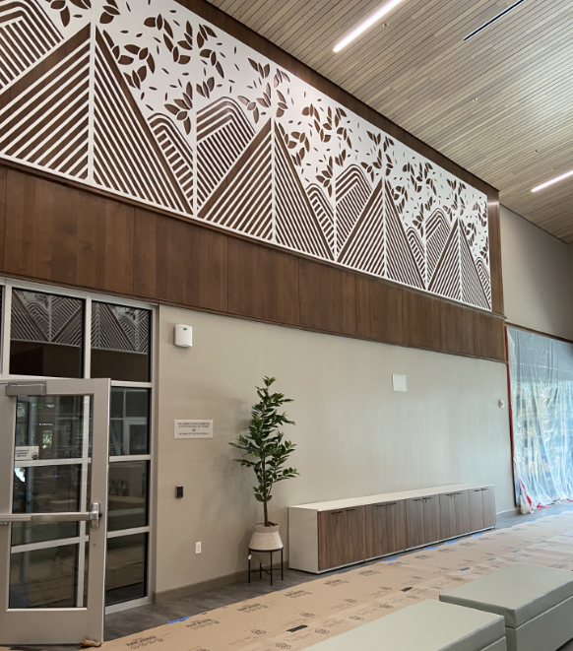
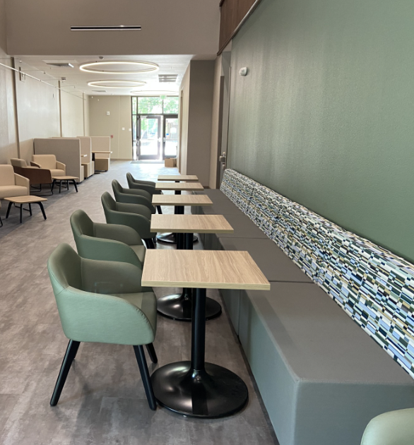
200 Building (Library) Renovation

Slide 3
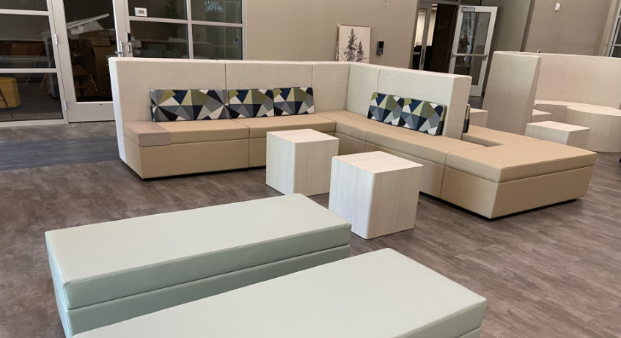
200 Building (Library) Renovation (continued)

Slide 4
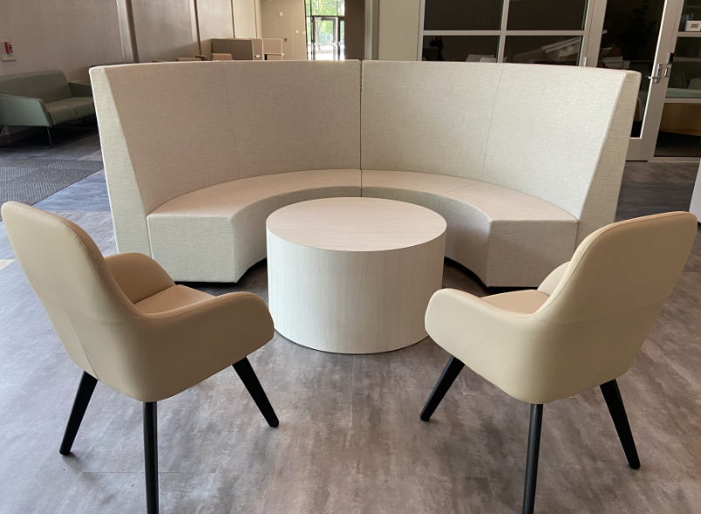
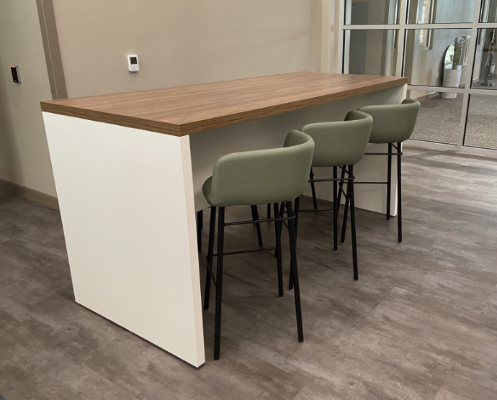
200 Building (Library) Renovation (continued)

Slide 5
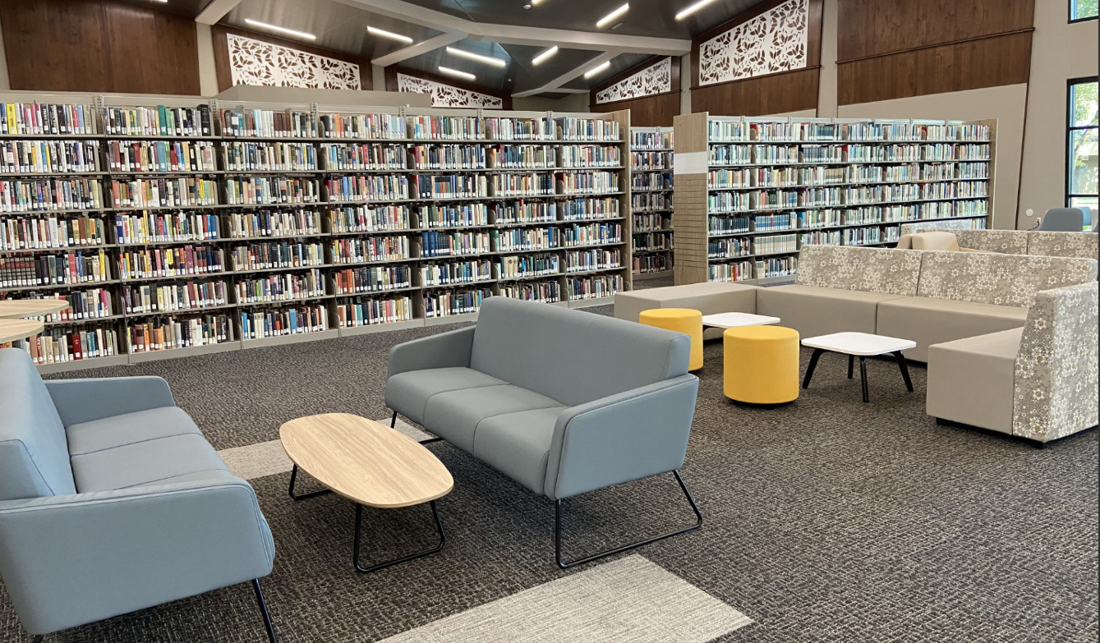
200 Building (Library) Renovation (continued)

Slide 6
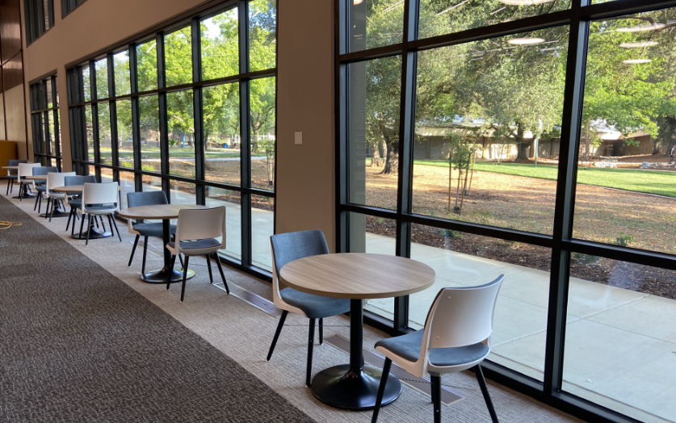
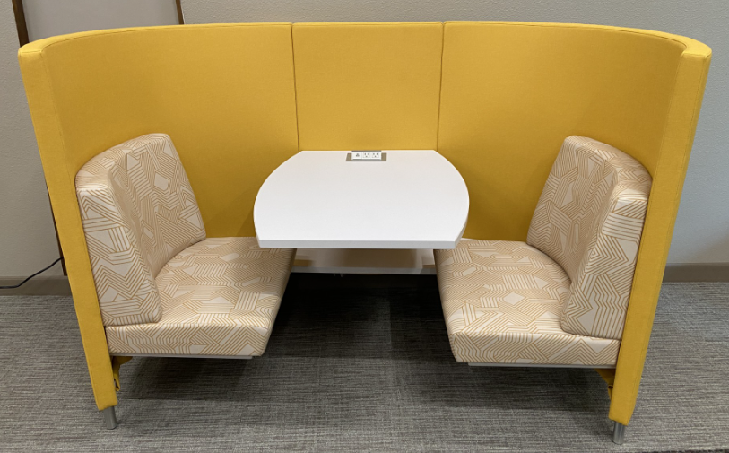
200 Building (Library) Renovation (continued)

Slide 7
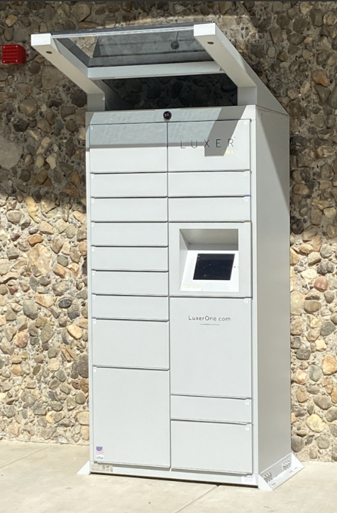
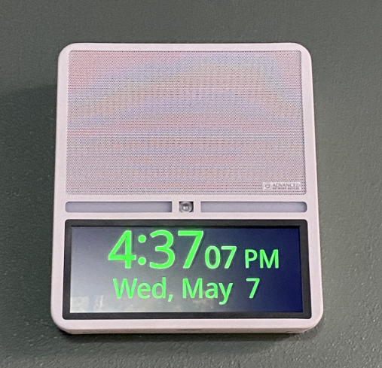
200 Building (Library) Renovation (continued)
Pick Up
Locker
VERKADA
Visual Notifier

Slide 8
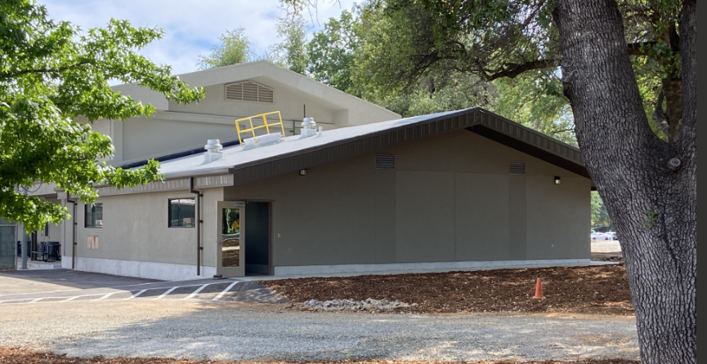
Bldg. 5200 Restrooms/Locker Rooms Addition

Slide 9
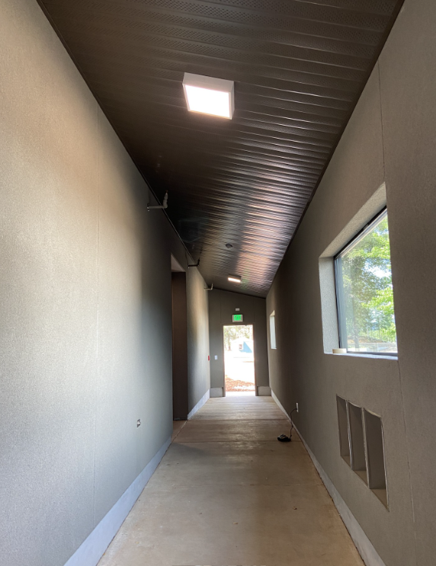
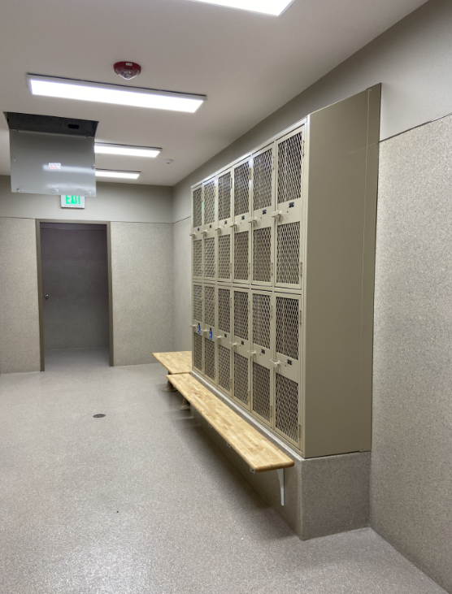
Bldg. 5200 Restrooms/Locker Rooms Addition (continued)
Women’s Locker Room

Slide 10
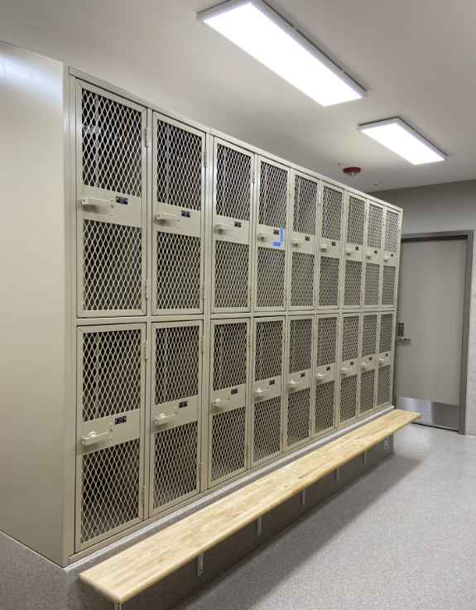
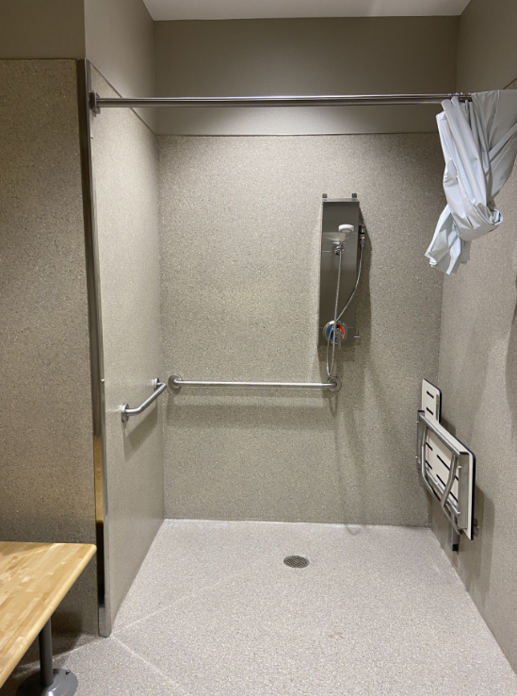
Bldg. 5200 Restrooms/Locker Rooms Addition (continued)
Men’s Locker Room

Slide 11
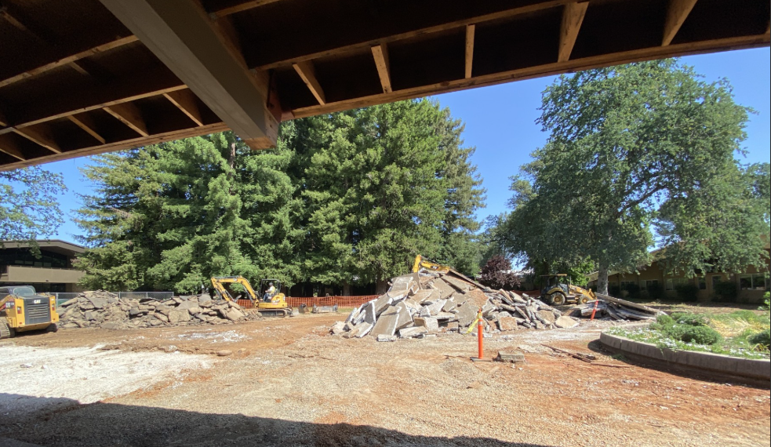
800 Building (Instructional Classrooms) Remodel

Slide 12
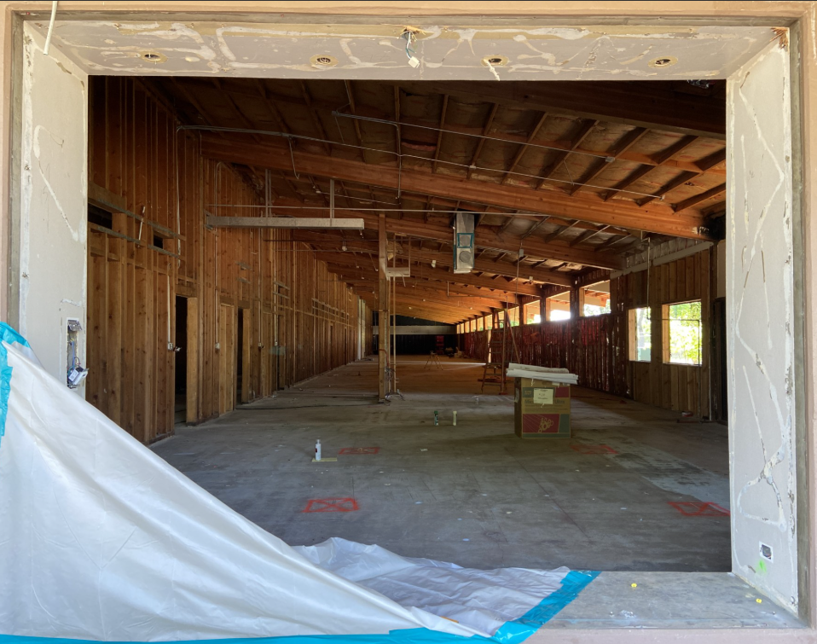
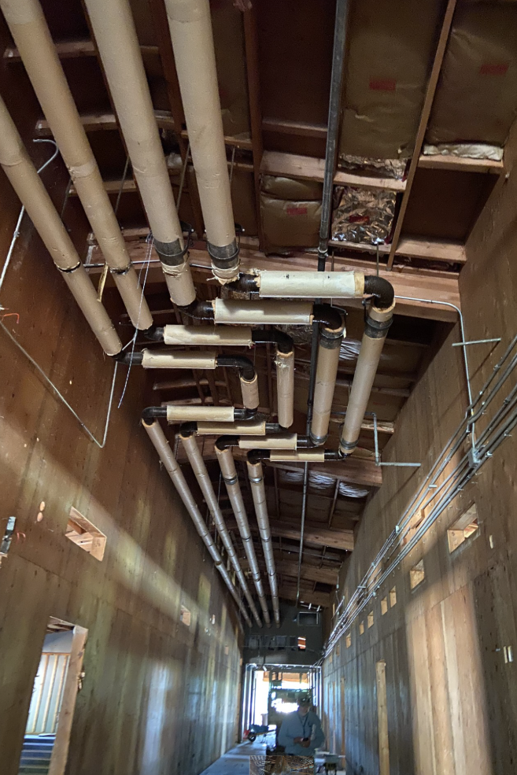
800 Building (Instructional Classrooms) Remodel (continued)

Slide 13
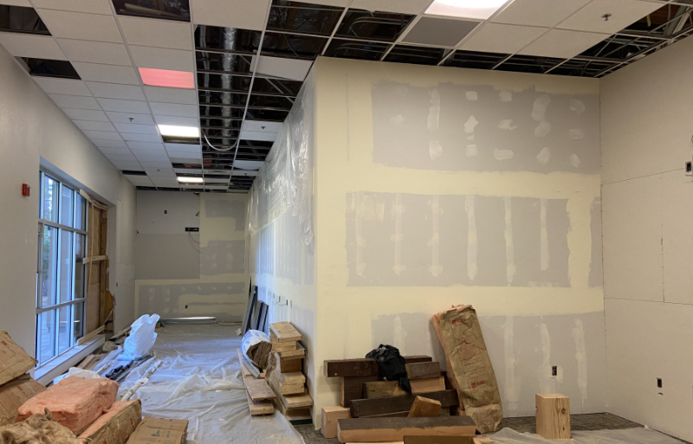
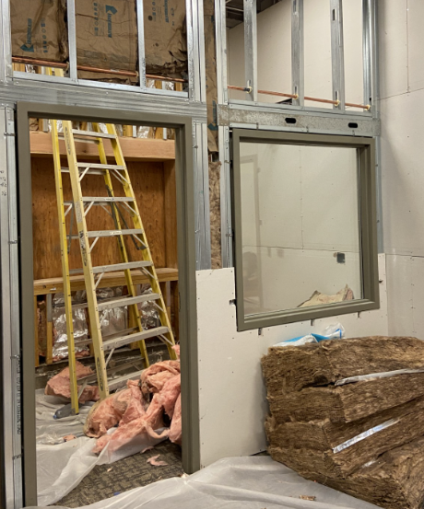
Bldg. 2300 Swing Space Remodel
Window Installation
Taking Place
Main Entry Door
to be Installed Soon

Slide 14
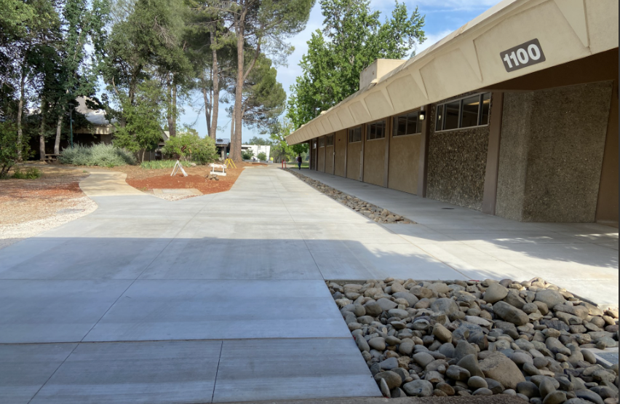
Sidewalk Replacement Project

Slide 15
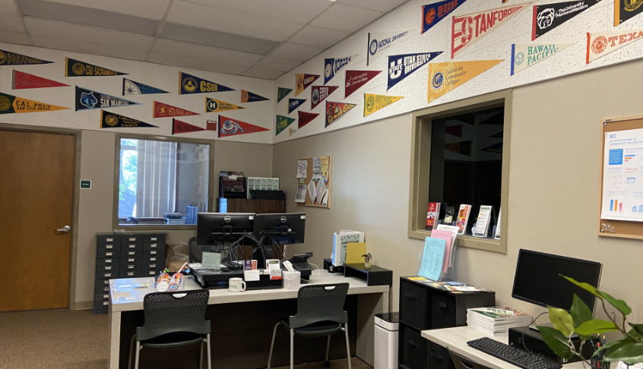
Bldg. 2100 Swing Space Remodel
Transfer Center

Slide 16
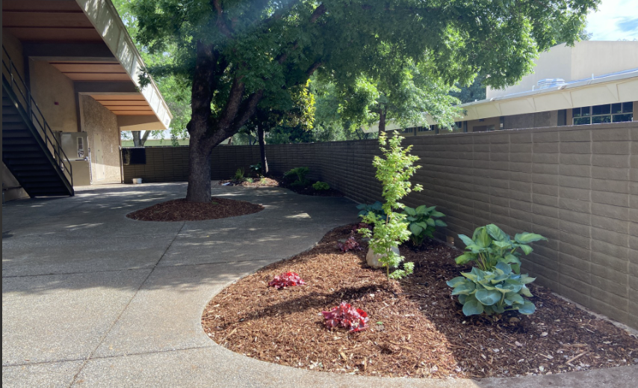
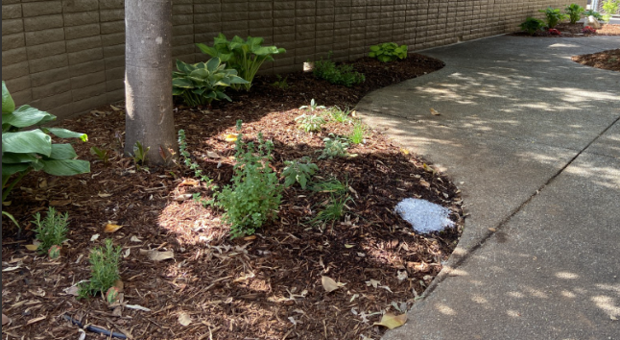
BISTRO Patio Refresh
Fresh Herbs Planted for use
by the Culinary Arts Program
Patio Wall and Staircase Painted
Landscaping Refreshed

Slide 17
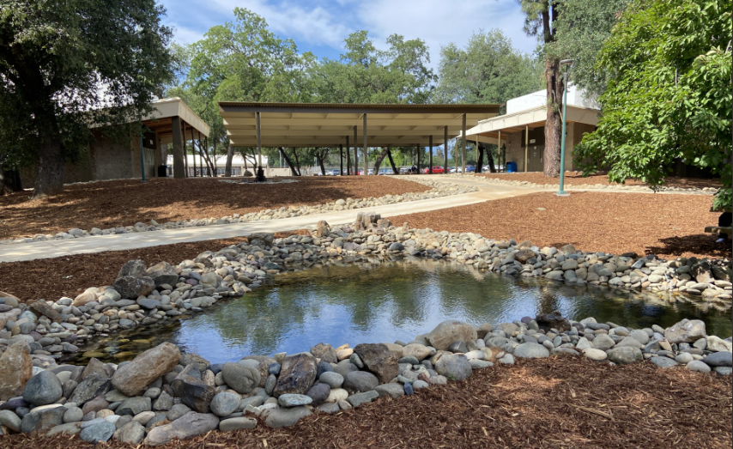
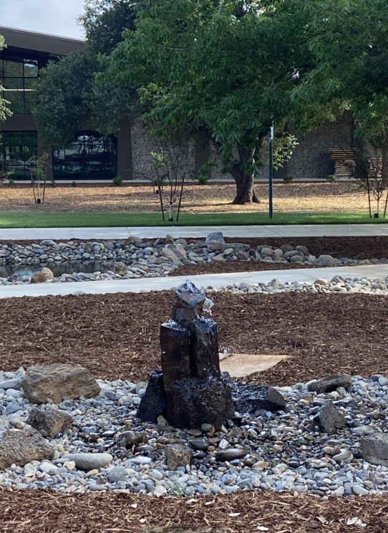
Ponds-Greenhouse-Observatory Project
Basalt Rock Fountain adjacent to the
Shade Structures

Slide 18
Other Capital Construction Projects
700 Building Renovation (Administrative Offices)
Bid award on tonight’s Board agenda for approval
Construction start date (estimate): August 2025
Construction end date (estimate): June 2026
Quad Renovation Project
This project is to replace the 1960’s era concrete at the main campus quad,
complete the required fire lane connection, correct ADA accessibility
issues, and provide improved student study and event spaces.
This project is undergoing additional review. A revised plan will be provided when it becomes available. Details on following page…

Slide 19
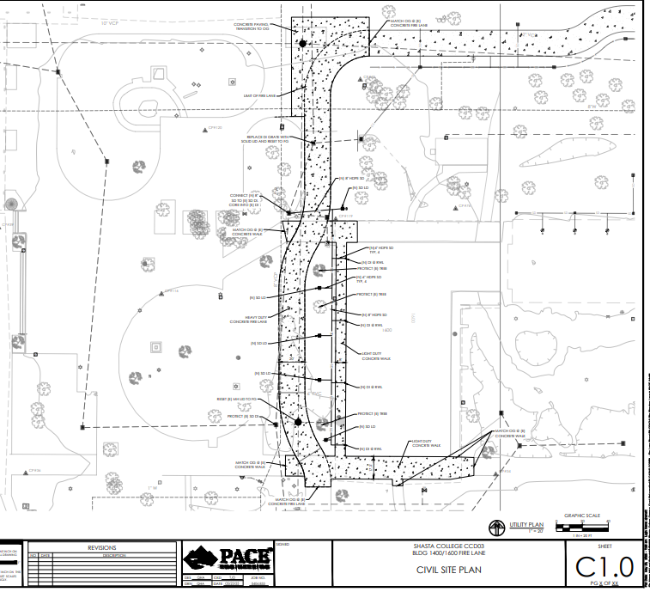
Other Capital Construction Projects
Fire Lane has been redesigned
Student input has been received and will be shared after review
Suggestions from the landscape architect have been received and are under review

Slide 20

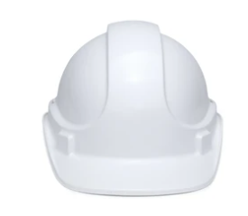

For more information…
About / Bond Projects / Measure H
Theresa Markword,
Interim AVP of Facilities &
Capital Construction
tmarkword@shastacollege.edu
(530) 242-7699
Sherry Nicholas,
Bond Project Coordinator
snicholas@shastacollege.edu
(530) 242-7527
Isabella Greenleaf,
Bond Project Coordinator
igreenleaf@shastacollege.edu
(530) 242-7978
Magan Kleinman,
Bond Program Fiscal Analyst
mkleinman@shastacollege.edu
(530) 242-7747
Janette Brockman,
Bond Program Administrative Professional II
jbrockman@shastacollege.edu
(530) 319-3214

